Slide 1
Data Science
What is data science?
Data science, also known as data-driven science, is an interdisciplinary field of scientific
Methods, process, algorithms and systems of extract knowledge or insights from data in various forms,
either structured or unstructured, similar to data mining

Slide 2



Machine Learning
Why??
More simple
More Fast
More exactly

Slide 3
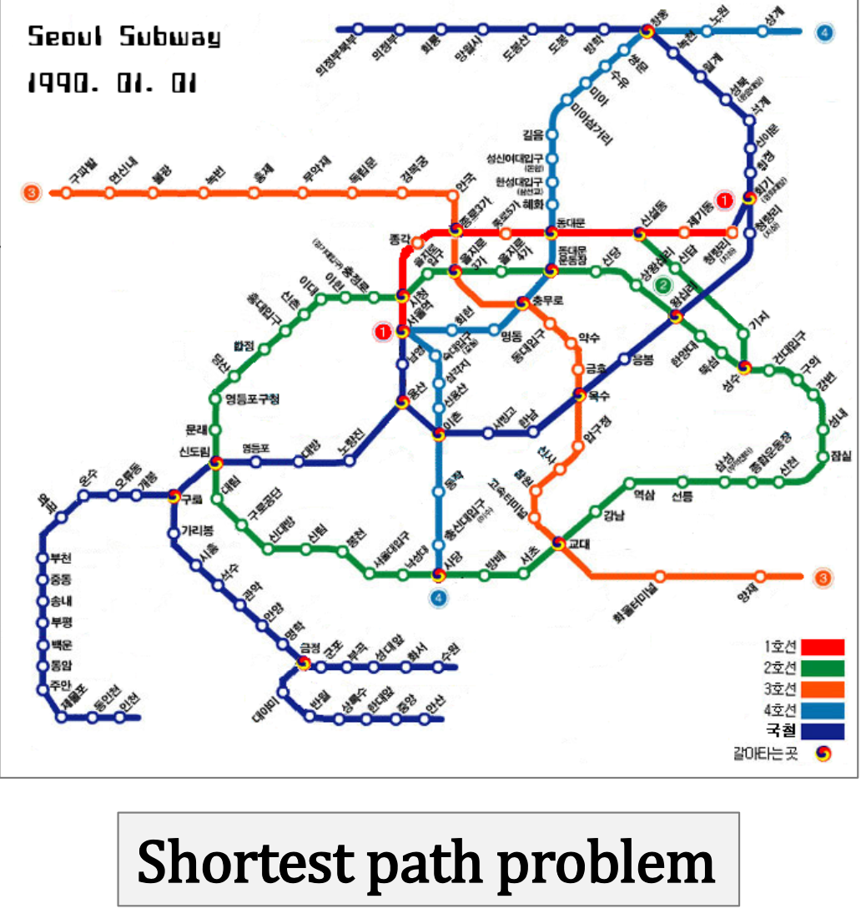
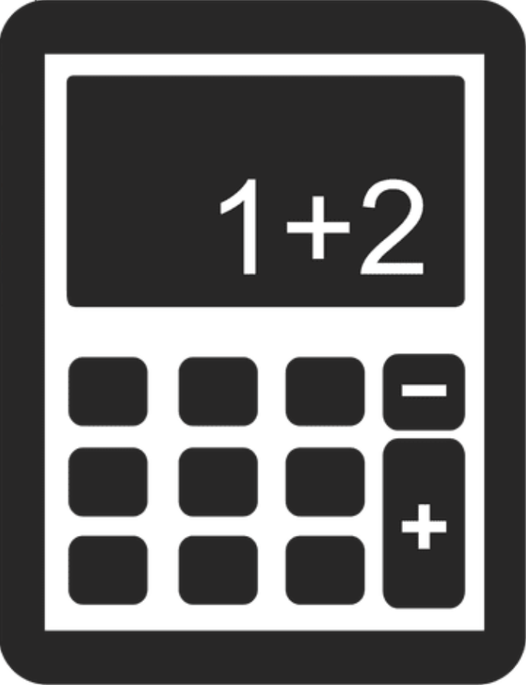
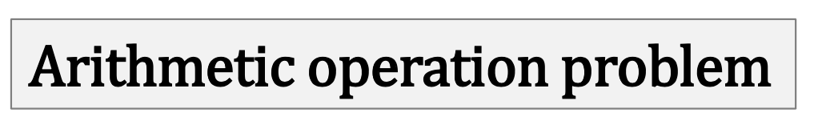
When?

Slide 4
기존 솔루션으로는 많은 수동 조정과 규칙이 필요한 문제
전통적인 방식으로는 전혀 해결 방법이 없는 복잡한 문제
유동적인 환경
복잡한 문제와 대량의 데이터에서 통찰 얻기
Useful
When machine Learning is needed
A pattern exists
We cannot pin it down mathematically
We have data on it

Slide 5
Supervised Learning

Slide 6


Supervised Learning
EMR
SMOK_QTY : 흡연량
MHIS_DBT_YN : 병력고혈압여부
MHIS_TB_YN : 병력 결핵 여부
MHIS_INSM_YN : 병력불면증여부
.
.
.
BRST_YN :병력 유방암 여부

Slide 7
Supervised Learning
Classification
regression
One class classification
Binary
classification
Multiclass
classification
Univariate regression
Multivariate Regression

Slide 8
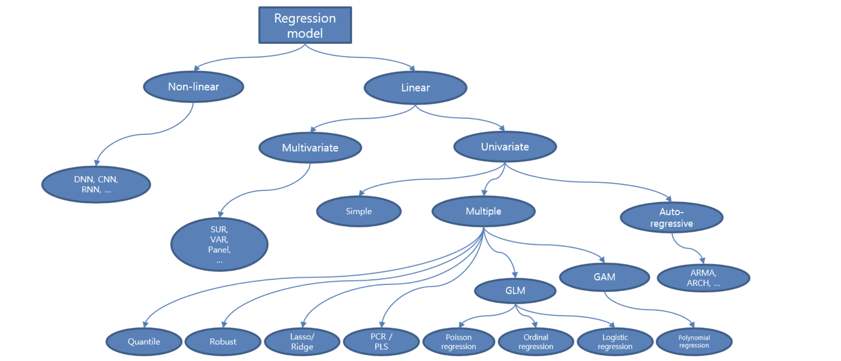

Slide 9
classification
regression
1
1
0
0

Slide 10
How Data scientist solve the problem?

Slide 11
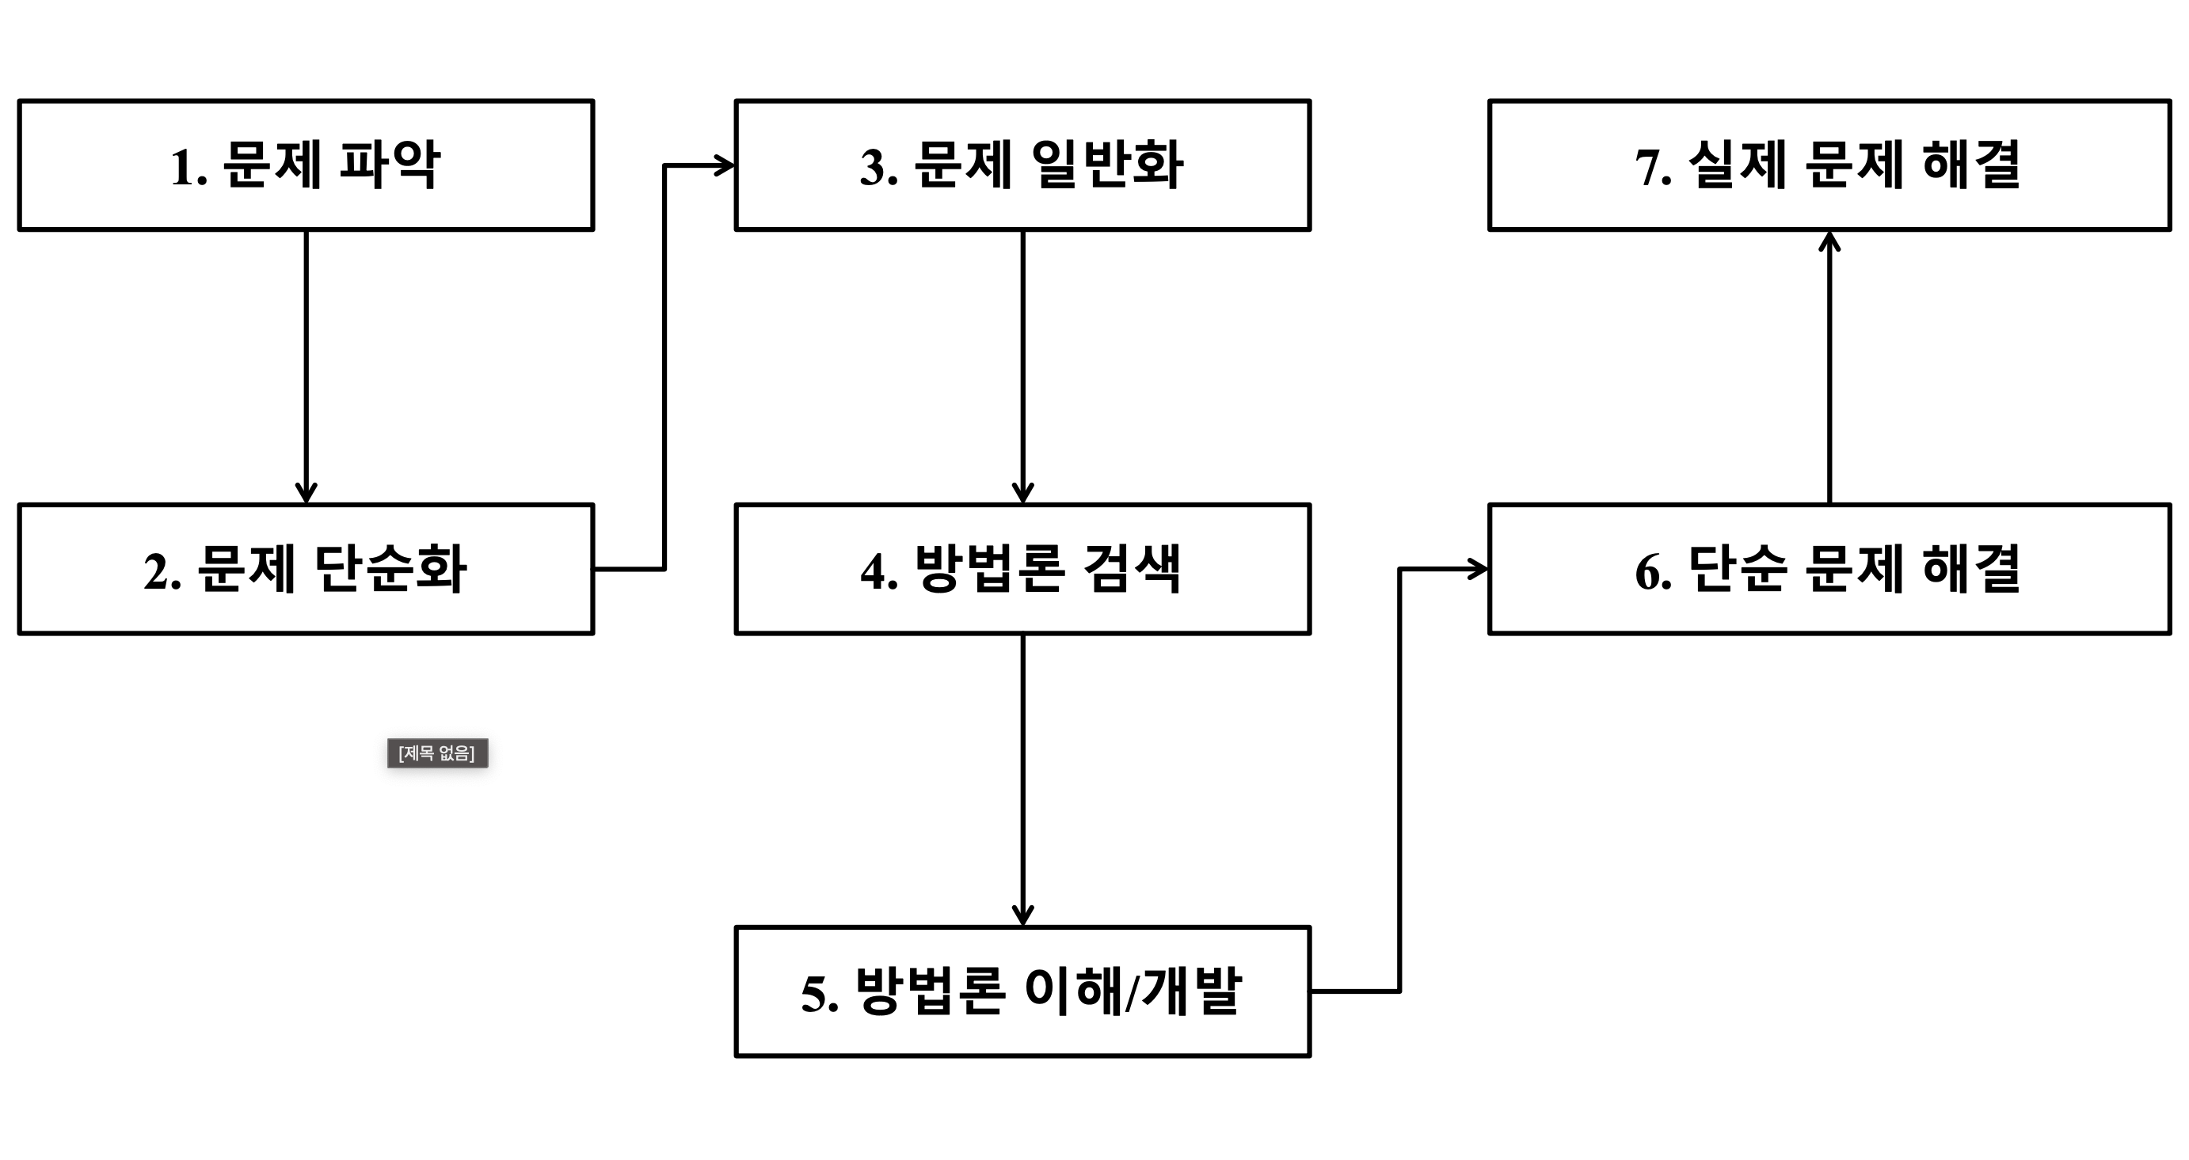

Slide 12
